Slide 1
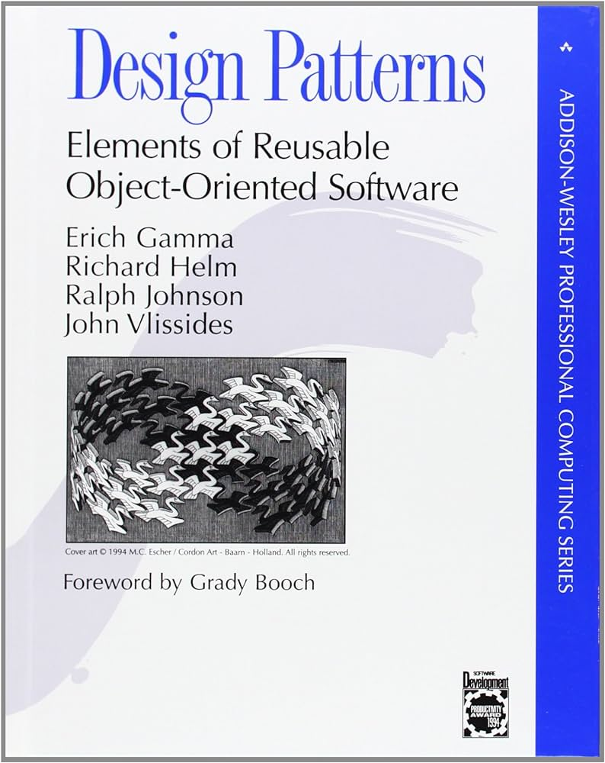
Object Oriented Design
Dave | 8/8/2024

Slide 2
What is an object?
Object = properties + methods
Properties = information about this object
Methods = functions you can use with this object
In python defined by classes

Slide 3
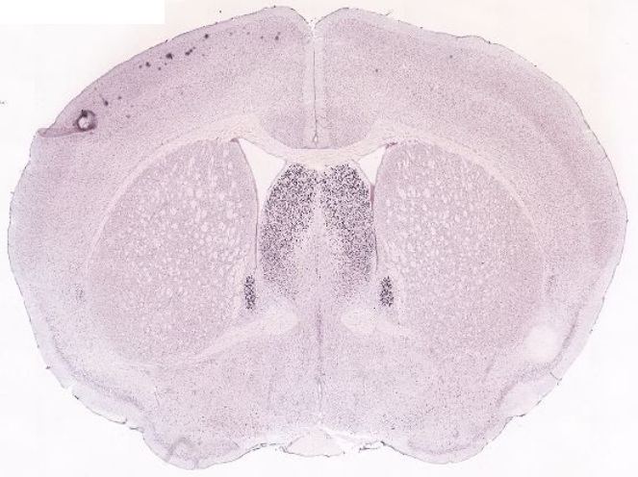
Common object you might deal with: Images
Images can be encoded many ways
Different file types
Color/Grey
Image libraries handle these differences and bring image data into a shared data structure (class)
Useful properties could be
Width, Height
Color format
Useful methods might be
crop()
color2grey()
threshold(some_thresh)

Slide 4
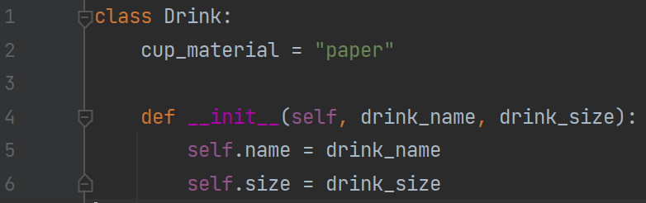
What defines an object?
It’s name(potentially it’s data type)
A constructor: in Python this is the __init__() function
Also can include:
Parameters/fields, referred to using self.
Methods: functions that can be used on all instances of this class
Class variables: static variables that exist for all instances

Slide 5
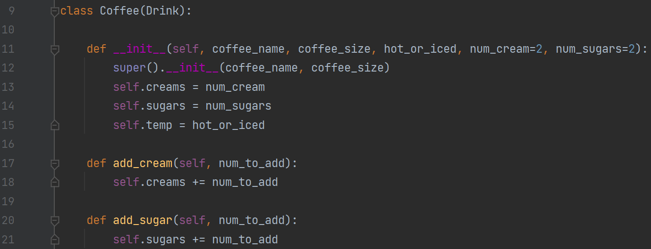
Inheritance: connecting objects together
Say we run a drink company and want to represent our various options
We have our basic drink object
Let’s use this class definition to define a more specific drink, with unique methods

Slide 6
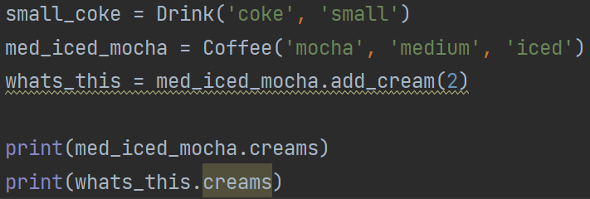
Using our rudimentary drink classes

Slide 7
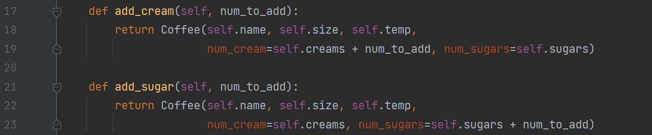
Mutability and aliasing
Mutability: the ability for an object to be changed after it is made
Aliasing: the idea that variables are not necessarily new objects but may reference (and can influence) existing objects

Slide 8
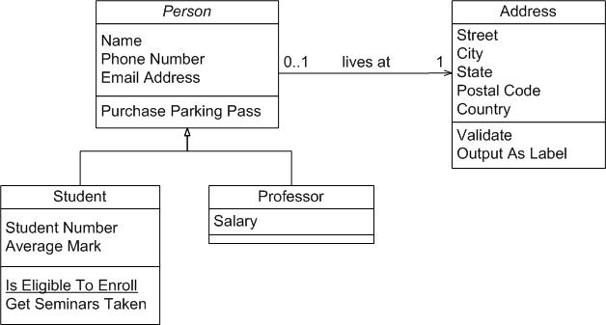
UML Diagrams: A way to visualize systems of inheritance
Not going into all the intricacies because it’s likely overkill for most people
Francesco Lelli

Slide 9
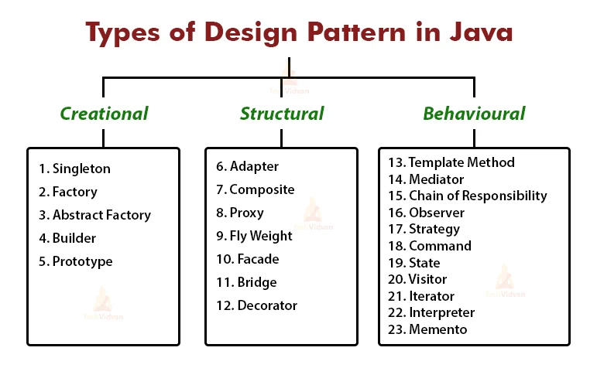
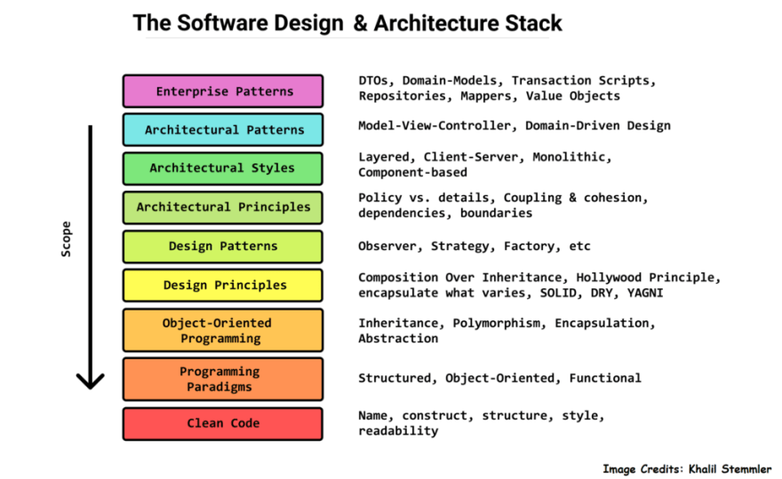
Design Patterns
Strategic deployment of objects to solve problems (sorry so abstract)
Certain problems benefit from certain design choices
GUIs -> MVC pattern
Converting between data standards -> Adapter pattern (wrappers)

Slide 10
Light preaching: consider MVC for data analysis
Model, View, Control
Overall principle is to separate data representation (Model), manipulation (control), and presentation (View)
Even if you’re not following some UML diagram, try not to mix data processing and plotting

Slide 11
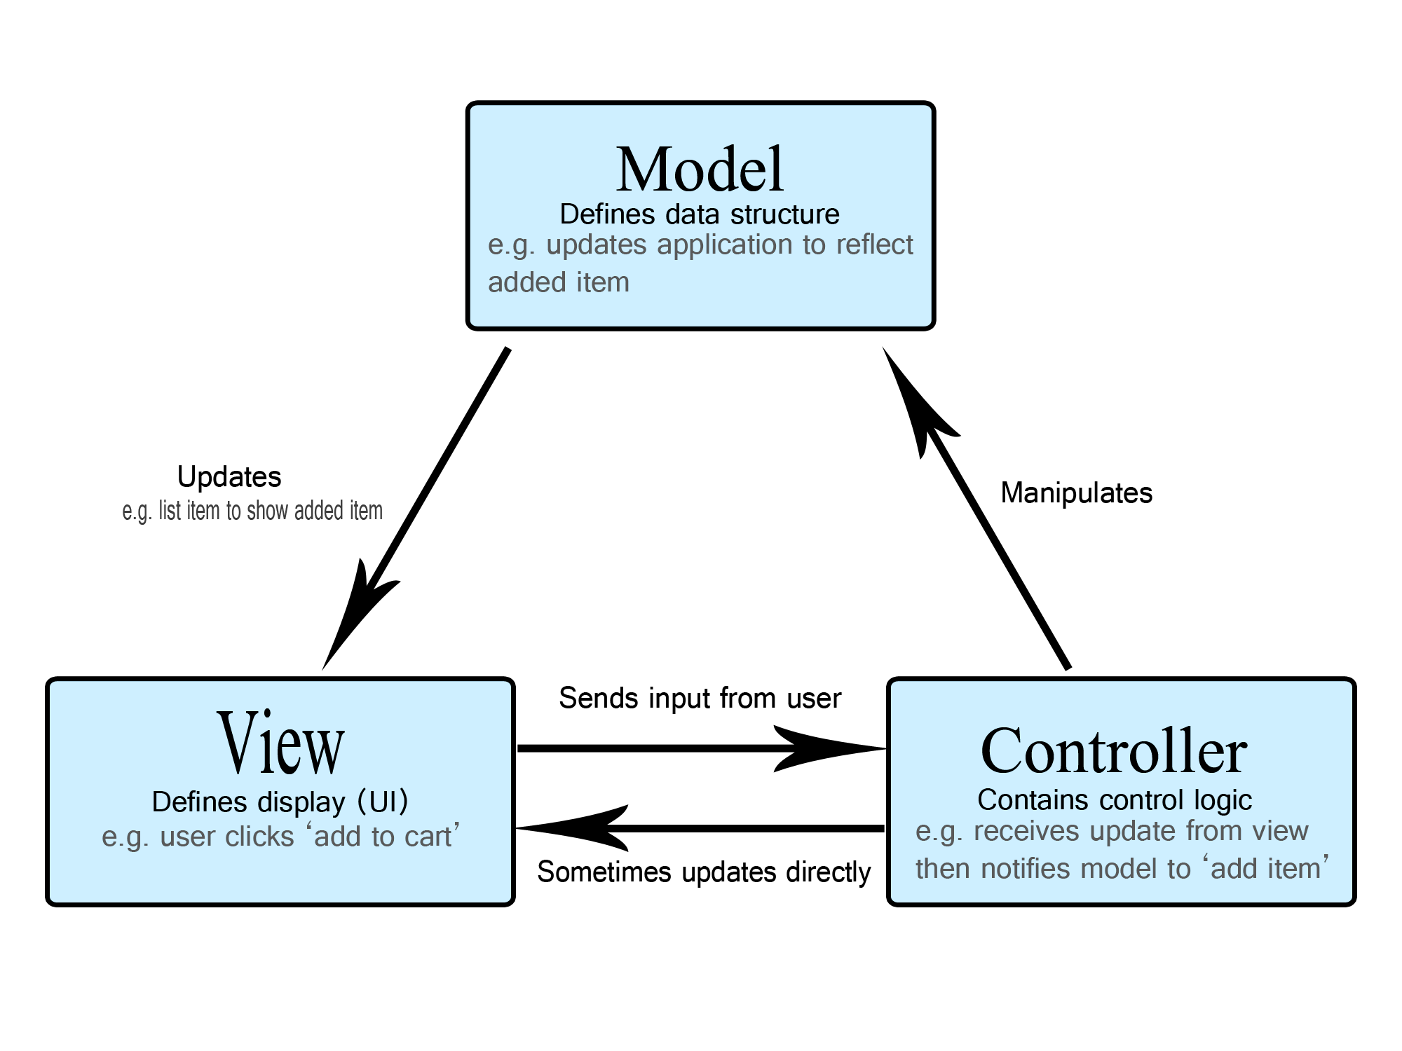
MVC Example: The simplest GUI
Motivation: you are collecting many images of tissue samples and need to process and visualize them in some way
the image data itself, could be numpy array or fancier Image object
the GUI that renders the model (typically matplotlib stuff)
collection of operations to manipulate the images (ROI detection, smoothing)

Slide 12
MVC Example: cont.
We start with 4 files
Main.py: our main function, all it does is makes a view object
Model.py: defines our Model which contains some image data in the form of a 2D numpy array
Control.py: defines our Control class which can access a manipulate a given Model
View.py: defines the View class which is the user-facing part of our software. It will render a given model and pass user input to the Control class
Order of operations
We execute main.py
This makes a View, Control, and empty Model
We call get_user_input() on the View
User inputs an image URL
The url is passed to load_image() in Control
load _image() sets the model data
We call update() on the View to see the image

Slide 13
Extending our software
MVC gives organizational benefits
Changing the controller doesn’t affect how the data are represented/break the rendering
All the rendering stuff doesn’t bloat the analysis
In general, the idea is to separate the functional units of your code into independent classes

Slide 14
Real world applications
Understanding novel classes and how they are organized is the basis of using other libraries (numpy, scipy, matplotlib)
Numpy arrays
Scipy KDTree
Matplotlib plot and image objects

Slide 15
How do we get these libraries?
Need to install to our environment using pip (pause to install numpy, scipy, matplotlib)

Slide 16
Numpy: a library for numerical processing
Likely most used library
Numpy arrays have more functionality than Lists

Slide 17
Numpy examples: working with numpy arrays
Can be made from simple lists
Can be made from lists of lists (matrices)
Can be n dimensional
Can be operated on by numerous methods (often more efficiently)
Iterable
No .append() instead need to use concatenation functions

Slide 18

Where all this comes together: Modeling
Typically models are represented by specialized classes, however there are always abstractions
Most models take in some input and return some output
Often (in like machine learning) models may need to be trained and that training saved within the model object
Anything else depends on the data itself

Slide 19
Starting simple
We want to make our own model
Input
Output
Model Class

Slide 20
Starting simple
We want to make our own model
TODO List:
.predict(input)
.fit(training_input)
.eval(input, true_out)
Input
Output

Slide 21
Exercise 1: The Kaminsky Model
Simplest possible model
Predicts whether the person running the code currently exists
Make a new modeling.py file
Start by defining a GenericModel which implements .predict() .fit() and .eval()
These can by default do nothing, it just guarantees that any GenericModel has them
Next define a JKmodel which extends the GenericModel
Implement .predict(some_input) for the JKmodel
Make a new run_models.py file
Import the JKmodel and try predicting with a JKmodel

Slide 22
Exercise 2: Running Average Model
Ok this one kinda doesn’t take input either…
But it does implement .fit()
Define a RAmodel in modeling.py which extends the GenericModel
The purpose of this model is to continually keep an average of the input it receives
This will be done via .fit()
Need to keep track of how many inputs have been received
When constructed, the RAmodel needs to initialize self.current_average and self.current_count
Implement .fit(data) so that it takes a list of numbers and updates the current_average
Implement .predict(input) so that it return the new average with the given input but doesn’t update
Try importing and calculating mean with your RAmodel, see if you get close to, but not exactly the mean with a alpha ~0.8 (this will depend on initial conditions)
Notes:
https://mark-kramer.github.io/Case-Studies-Python/01.html

